Slide 1

Heart Failure Risk Prediction Model
Manuel Duran
DSC 680
Final Project 1

Slide 2
Table of Contents
01
02
03
04
05
The Disease
Data Understanding
EDA
Background of the Disease
Review of Data
EDA performed on Dataset
Model Creation
Conclusion\Questions
Review of model creation
Final Remarks and Discussion

Slide 3
01
The Disease
Background of the Disease

Slide 4

Heart Diease #1 Leading Cause of Death in USA

Slide 5
About the Disease
36 Seconds
The Numbers
The World
A person Dies from Heart Failure
About 655K Americans Die
each year
Leading casue of death for most Racial\Ethnic Groups

Slide 6
02
Data Understanding
Review of Data

Slide 7
The Data
Data Acquired from Kaggle Website
Records of several patients featuring their Death Events.
Additional Features
Age
Patient Status (Age\Diabetes\High Blood Pressure\Smoker)
Medical Measurements (Serum Creatine\Sodium)
Link: https://www.kaggle.com/andrewmvd/heart-failure-clinical-data

Slide 8
03
EDA
EDA Performed on Data

Slide 9
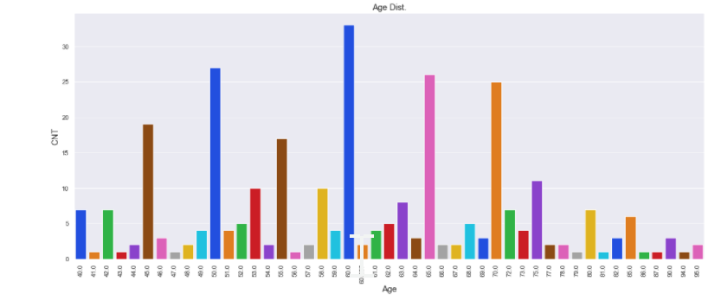
Age Group Distribution

Slide 10
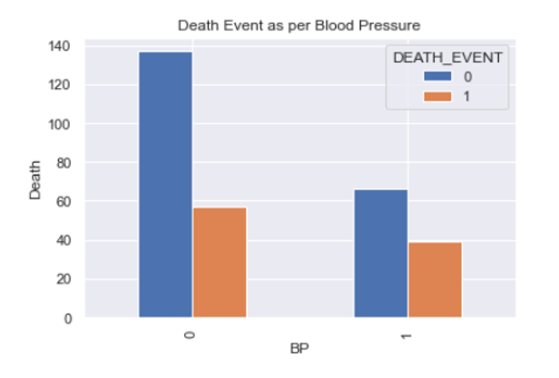
Crosstab Bar Chart

Slide 11
04
Model Creation
Review of Model Creation

Slide 12
Selected Features\Variables Model
Age
Ejection Fraction
Serum Creatine
Serum Sodium
Time
Age of Patient
Percentage of Blood Leaving The Heart
Levels within the Blood
Levels within Blood
Follow Up Period Between Appointments

Slide 13
Results of Model Creation
 | Model Accuracy | Precison Score | Recall Score
Results | 90% | 78.57 | 78.57

Slide 14
05
Conclusion\Questions

Slide 15

Conclusions
Model Performance very well; however, maybe too high.
Patient Measurement > Activities or Status
Room For Growth
Include Gender\Race
Additional Heart Measurements

Slide 16
Questions?
Link: https://github.com/mannyoduran/DSC680-Projects/blob/main/Project%201/Project%201%20Heart%20Failure%20DSC%20680%20MDURAN.ipynb

